Slide 1
Pet Reunite Hub
Team No. 85
Sameer Gonde [21BCT0304]
Ayush Katkurwar [21BCE0856]
Siddhant Saraf [21BDS0137]
Aryaan Kharbade [21BCE3296]
Sarthak Rajput [21BCE3249]
Date : 20/11/23
Notes:
Title Slide
Project Name: The title of the AWS-based project.
Team Members: Names and roles of all team members.
Date: Presentation date.

Slide 2
Introduction
Building a Platform that enables users to report lost or found pets and help reunite lost animals with their owners.
Many pets get lost, and owners struggle to find them
Notes:
Introduction
Brief Outline: A summary of what the project is about.
Objectives: High-level goals to be covered in the presentation.

Slide 3
Project Objectives
To create a centralized platform that facilitates the reuniting of lost pets with their owners, promoting responsible pet ownership and reducing the number of animals entering shelters.
Reduce pet loss and abandonment
Promote responsible pet ownership
Strengthen community engagement
Create a positive impact on animal welfare
Notes:
Project Objectives
Goals: Specific milestones or deliverables.
Expected Outcomes: What the project aims to achieve.

Slide 4
Project Scope
Assess the effectiveness of educational campaigns by measuring changes in public awareness and responsible pet ownership practices.
Evaluate the impact of the platform on the number of lost pets reunited with their owners compared to traditional methods.
Measure the level of satisfaction among pet owners who have utilized the platform's support services.
Notes:
Project Scope
Statement: The project statement as provided by the instructor.
Scope Boundaries: What is and isn't covered by the project.

Slide 5
Individual Contributions
Member 1 - Ayush: Frontend
Member 2 - Siddhant: Frontend
Member 3 - Sameer: Frontend and Backend
Member 4 - Aryaan: Frontend and Backend
Member 5 - Sarthak: Frontend and Backend
Notes:
Individual Contributions
Member 1: Specific role and tasks performed.
Member 2: Specific role and tasks performed.
Member 3: Specific role and tasks performed.
Member 4: Specific role and tasks performed.
…

Slide 6


Key Concepts
MongoDB: MongoDB, a NoSQL database, serves as the backbone of Pet Reunite Hub, providing a scalable and flexible foundation for storing and managing vast amounts of pet data. Its document-oriented structure facilitates efficient storage and retrieval of pet profiles, including detailed information such as breed, color, and unique markings. This ensures that lost pets can be accurately identified and matched with their owners.
ReactJS: ReactJS, a JavaScript library, plays a pivotal role in crafting Pet Reunite Hub's user-friendly interface. Its component-based architecture enables the creation of interactive and responsive web pages, allowing users to effortlessly report lost or found pets, browse through profiles, and filter search results. ReactJS ensures a seamless navigation experience, simplifying the search process for pet owners.
Notes:
Key Concepts
Features: Important AWS features utilized.
Services: Key AWS services employed and their significance.

Slide 7

NodeJS and ExpressJS: NodeJS, a JavaScript runtime environment, and ExpressJS, a web application framework, form the core of Pet Reunite Hub's backend infrastructure. NodeJS's asynchronous event-driven architecture facilitates efficient handling of user requests, while ExpressJS provides a robust framework for building RESTful APIs. Together, they power the platform's search functionality, matching algorithm, and user authentication mechanisms.
Combining Technologies for a Transformative Impact: The integration of MongoDB, ReactJS, NodeJS, and ExpressJS in Project Pet Reunite Hub empowers the platform to address the challenges of pet loss and reunification. By harnessing the strengths of these technologies, Pet Reunite Hub aims to revolutionize the way lost pets are found and returned to their loving homes.

Slide 8
Challenges and Solutions
Challenges
Effectively connecting lost pets with their owners using a matching algorithm
Ensuring the accuracy and completeness of pet profiles to improve matching accuracy
Fostering a supportive and engaged community of pet lovers to aid in the search process
Reaching a wide audience and generating awareness of the platform to increase its usage
Securing funding and resources to sustain the platform in the long term
Notes:
Challenges and Solutions
Problem 1: Description and resolution.
Problem 2: Description and resolution.

Slide 9
Solutions
Implement a machine learning-based matching algorithm that considers various data points
Require users to provide detailed pet information and implement user verification mechanisms
Create a welcoming online community, host regular events, and promote community engagement
Partner with animal shelters, rescue organizations, and veterinary clinics for promotion
Pursue funding from foundations, corporations, sponsorships, individual donations, and premium features

Slide 10
Lessons Learned
Technical Insights:
Scalable Data Infrastructure:
User-Friendly Interface with Rich Functionality
Robust Backend for Efficient Operations:
Data Security and Privacy:
Localization and Language Support:
Continuous Monitoring and Maintenance:
Notes:
Lessons Learned
Technical Insights: What was learned technically.
Process Insights: What was learned about team collaboration.

Slide 11
Process Insights:
Technology-Driven Matching Algorithm
Data-Driven Decision Making
Continuous Improvement and User Feedback
Effective Communication and Collaboration
Data Integrity and Verification
Outreach and Awareness Campaigns

Slide 12
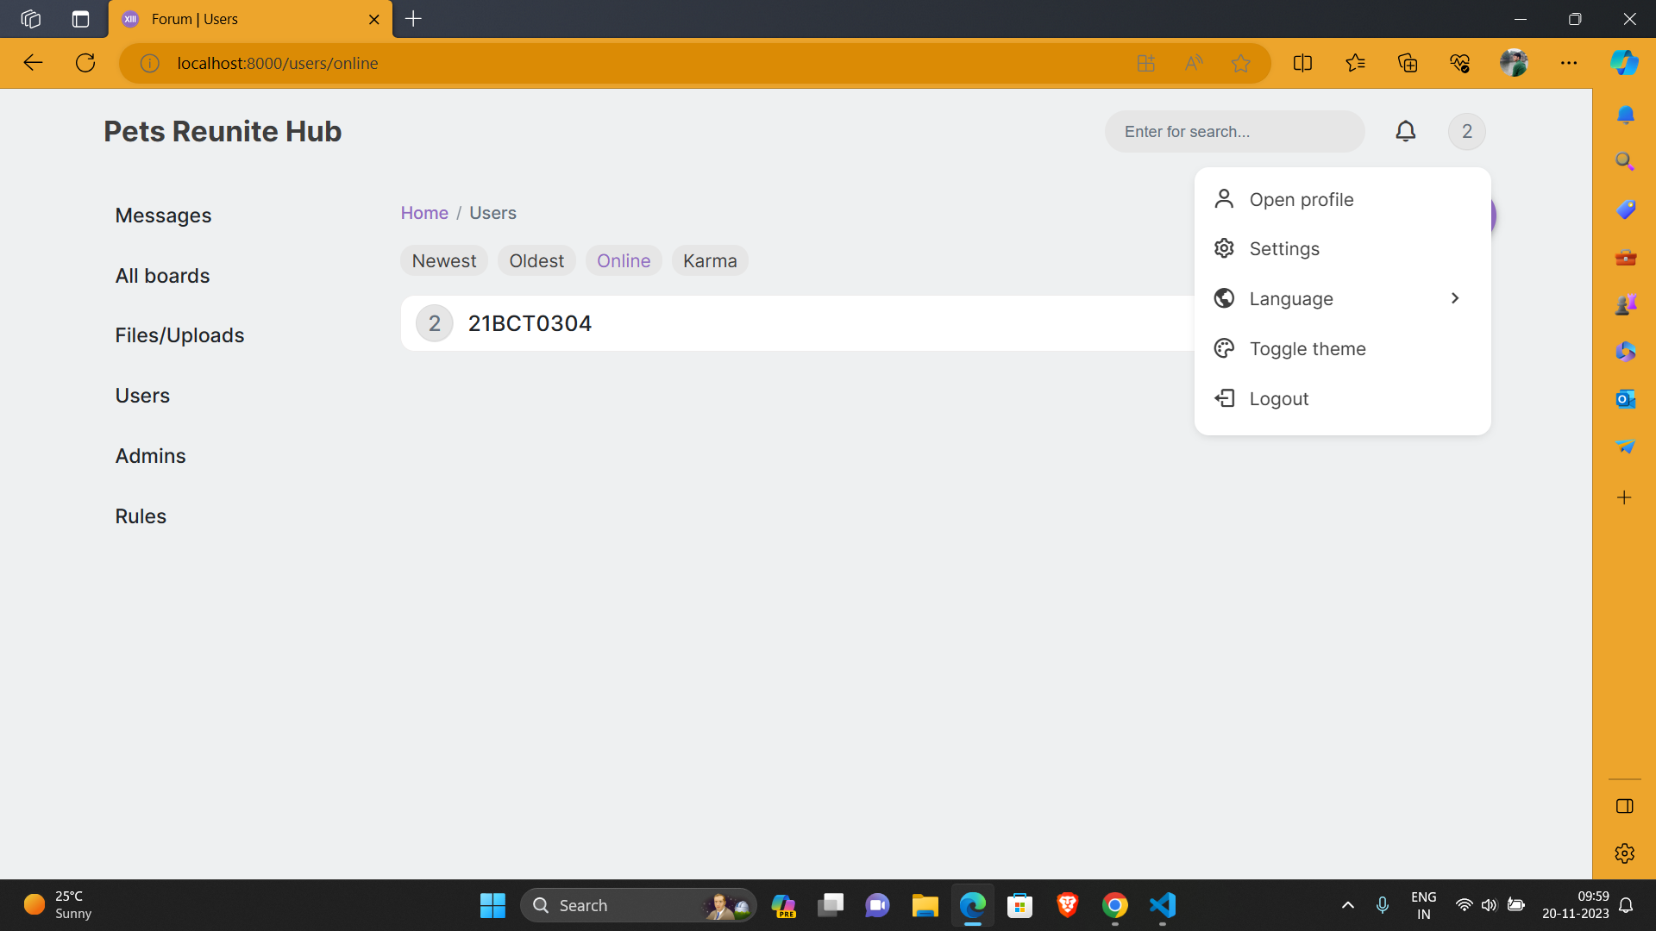
Screenshots
Notes:
Screenshots
Screen Captures: Visual snapshots to showcase key elements.
Context: Description explaining what the screenshot represents.

Slide 13
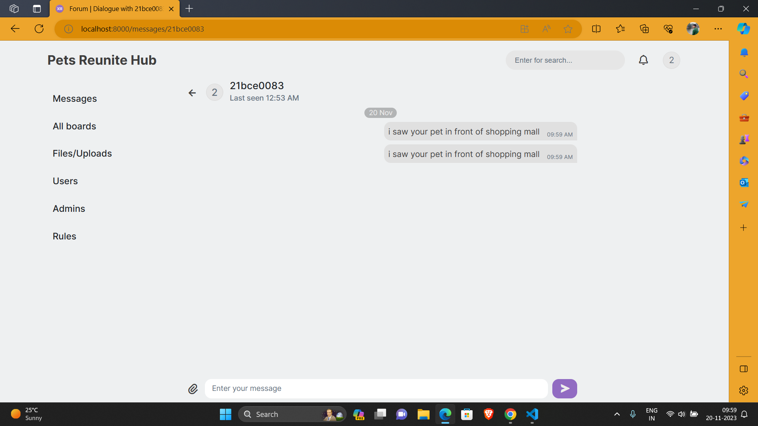

Slide 14
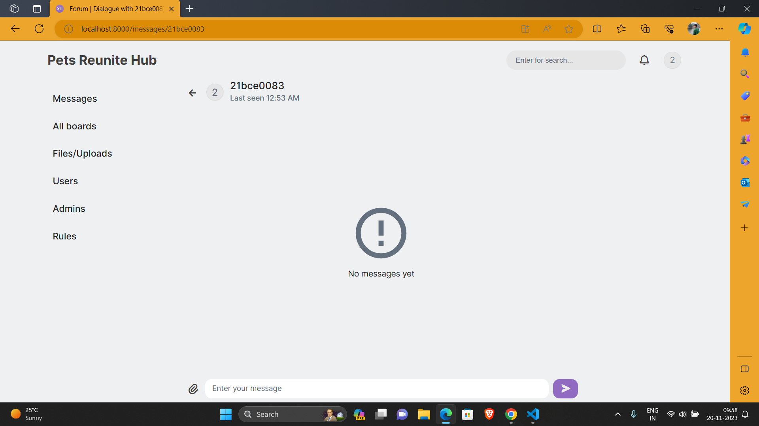

Slide 15
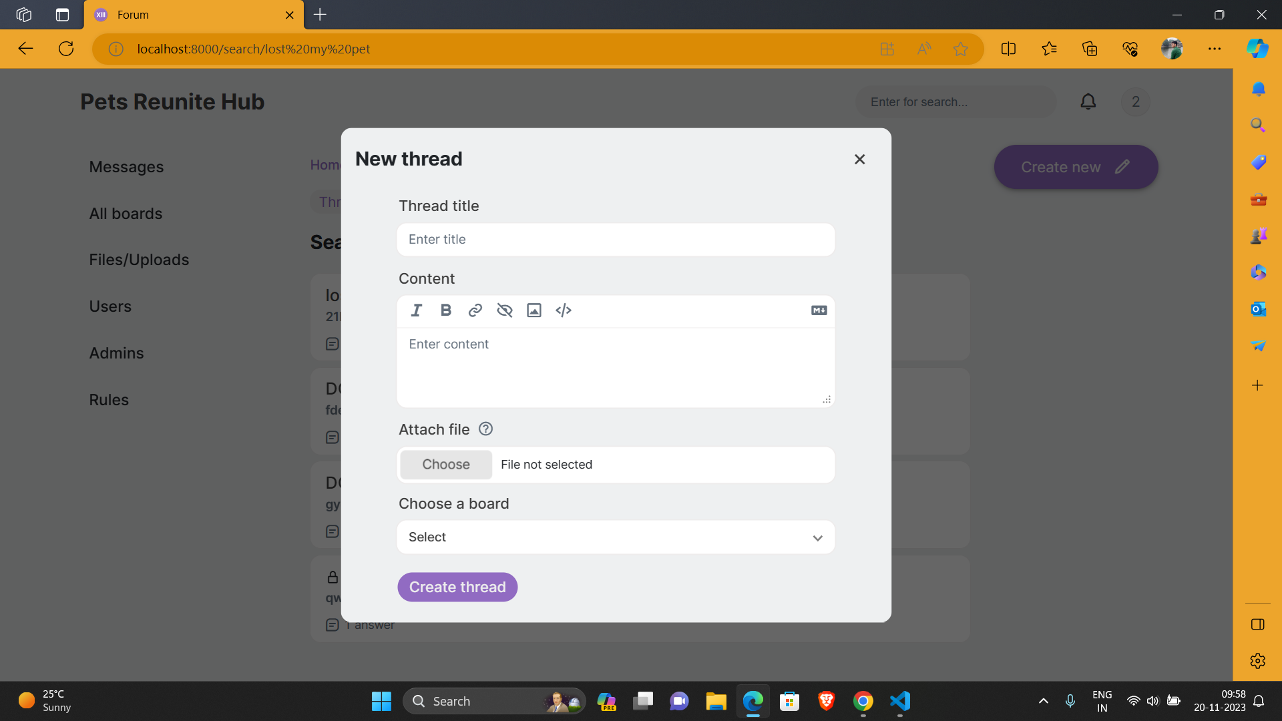

Slide 16
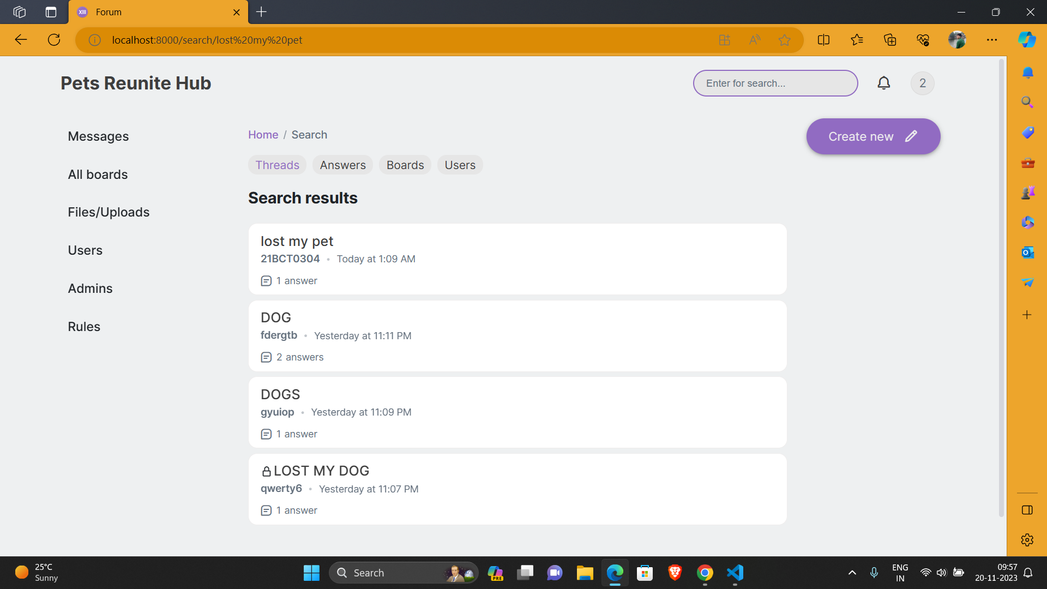
Notes:
Screenshots
Screen Captures: Visual snapshots to showcase key elements.
Context: Description explaining what the screenshot represents.

Slide 17
Future Scope
Improvements: Project Pet Reunite Hub holds immense potential to expand its scope and impact in the future. By leveraging emerging technologies and expanding its reach, the platform can continue to revolutionize the way lost pets are found and reunited with their owners.
Integration with Pet Identification Technologies
Real-time Location Tracking
Collaboration with Animal Rescue Organizations
Educational Resources and Awareness Campaigns
Data-driven Insights and Analytics
Notes:
Future Scope
Improvements: Potential updates or add-ons.
Next Steps: Future phases or expansions.

Slide 18
Next Steps: Project Pet Reunite Hub is poised for continued growth and expansion, with a vision to become a global platform for lost pet recovery.
Phase 2: Enhanced Matching and Search Capabilities
Phase 3: Global Expansion and Multilingual Support
Phase 4: Multi-Platform Presence and Community Engagement
Phase 5: Diversifying Features and Revenue Streams

Slide 19
How It Works
We are making a user friendly website to easily report a missing pet in the website.
Sign Up and Login page for each owner.
Separate database for lost pets and found pets using MongoDB
It will have search and filter functions that will help users to sort out the best possible match for the missing pet from the database.
Notes:
Q&A
Questions: Opening the floor for any questions from the audience.

Slide 20
Thank You!
Pet Reunite Hub
Sameer Gonde [21BCT0304]
Ayush Katkurwar [21BCE0856]
Siddhant Saraf [21BDS0137]
Aryaan Kharbade [21BCE3296]
Sarthak Rajput [21BCE3249]
Notes:
Thank You
Acknowledgments: Thanks to those who contributed.
Contact Info: How to reach the team for further queries.

